Slide 1
Plagiarism Checker using Python
Kumar Raushan (19BEC040)
Salla Chaitanya Krishna (19BEC077)
Siddhant Vardhan Singh (19BEC088)
Notes:
We designed this template so that each member of the project team has a set of slides with its own theme. Members, here’s how you add a new slide to just your set:
Mark where you want to add the slide: Select an existing one in the Thumbnails pane, click the New Slide button, then choose a layout. The new slide gets the same theme as the other slides in your set.
Careful! Don’t annoy your fellow presenters by accidentally changing their themes. That can happen if you choose a different theme from the Design tab, which changes all of the slides in the presentation to that look.

Slide 2


Agenda / Topics
Project Description
Procedure/Methodology
Key Findings/ Results
Working Code (Python)
Understanding Code
Key features
Further Development
SCIKIT-LEARN LIBRARY
NUMPY LIBRARY
CASE STUDY
CONCLUSION

Slide 3
Project Description
Objective
Results
My Objective is to create a Plagiarism Detector using Python – High Level Language.
Once finished our plagiarism detector will be capable of loading a student’s assignment from files and then compute the similarity to determine if students copied from any other document.

Slide 4
Procedure/Methodology
Identification of the file to be compared
Conversion of the file to the comparable format
Conversion of the characters into binary vector file.
Finding of similarity between the compared files.
Listing the similarity percentage on the output terminal.

Slide 5
Key findings/results
We can download the Report of the extent of the plagiarism in a particular work with other original documents.
During this project, we get to know about that this project can be implemented in various technologies such as face recognition, handwriting to text convertor, and many more technologies which are considered magic in recent time.

Slide 6
Working Methodology

Slide 7
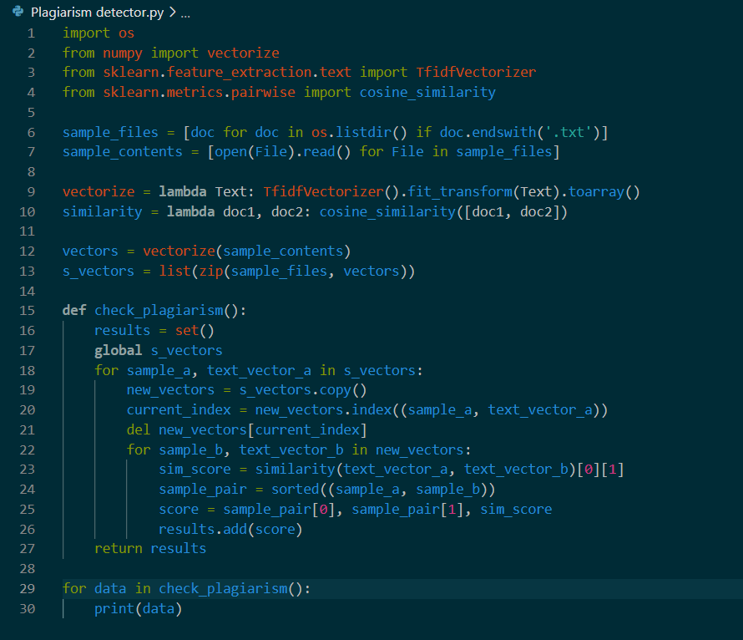
Working Code (Python):

Slide 8
Understanding Code:
In order to use scikit-learn library, we need to install it first:
We can install it using command prompt
Run command "pip install –U scikit-learn"

Slide 9

Understanding Code:
Import os:
We are importing os module in our program.
The OS module in Python provides functions for creating and removing a directory (folder), fetching its contents, changing and identifying the current directory, etc.

Slide 10

Understanding Code:
From numpy import vectorize:
Numpy is a python library which works with multidimensional array, and it also has in-built functions for fourier transforms and all.
numpy.vectorize takes a function f:a->b and turns it into g:a[]->b[].

Slide 11

Understanding Code:
From sklearn.feature_extraction.text import TfidfVectorizer
Tf means term-frequency while tf-idf means term-frequency times inverse document-frequency. This is a common term weighting scheme in information retrieval, that has also found good use in document classification.

Slide 12

Understanding Code:
from sklearn.metrics.pairwise import cosine_similarity
Compute cosine similarity between samples in X and Y.
Cosine similarity, or the cosine kernel, computes similarity as the normalized dot product of X and Y:
K(X, Y) = <X, Y> / (||X||*||Y||)

Slide 13

Understanding Code:
Source_files and source_contents
Source_files identify the nature of the file to be in text format.
Source_contents keeps the contents of the file , it is accessed after the verification of the file.

Slide 14

Understanding Code:
Vectorize and similarity
It is used to transform the file text using vector array fit.
Similarity parameter combines the document pairwise using its cosine similarity.

Slide 15

Understanding Code:
Vectors and s_vectors:
Vectors keeps the vectorized sample_contents.
S_vectors pairs each sample_file with its vectors.

Slide 16
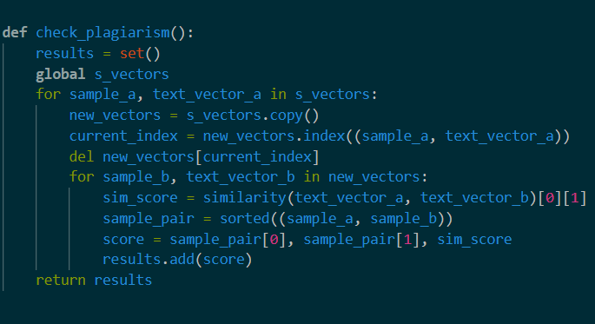
Understanding Code:
Check_plagiarism function:
This function performs the required task using the comparision in the array of vectors.
It finally assignes the simulation score to the variable sim_score.

Slide 17
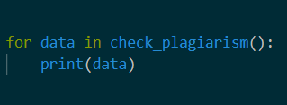
Understanding Code:
function calling :
The function is called using this code snippet for each segment in the datafile.

Slide 18
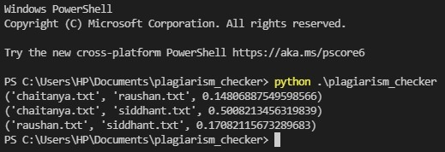
Understanding Code: Output
Final output:
The percentage of similarity between the files is clearly visible pairwise.

Slide 19
Key Features

Slide 20
Key Features
Our project is a "Plagiarism checker" which deals with comparing the percentage match of two documents in the current directory.
This project can check multiple files simultaneously.
This project can be extended to do the comparison in handwritten documents too. Later it can be used for the comparison of Images which are present in document by converting them to text.

Slide 21
Further Development:
Our project is currently in development phase and works with only .txt file format, but later it can be extended towards working with all kind of document such as (PDF, PPTX, DOCX and all).
It can also check for the corrupt files or any virus in the form of text.

Slide 22
SCIKIT-LEARN LIBRARY
Simple and efficient tools for predictive data analysis
Accessible to everybody, and reusable in various contexts
Built on NumPy, SciPy, and matplotlib
Open source, commercially usable - BSD license
Scikit-learn is an open source machine learning library that supports supervised and unsupervised learning. It also provides various tools for model fitting, data preprocessing, model selection, model evaluation, and many other utilities.

Slide 23
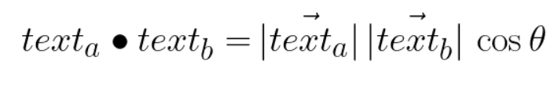
SCIKIT-LEARN LIBRARY
Scikit-learn provides dozens of built-in machine learning algorithms and models, called estimators. Each estimator can be fitted to some data using its fit method.
To use this library we need to install it in our system. To install it, we have used Python installation Package (PIP)

Slide 24
NUMPY
NumPy, which stands for Numerical Python, is a library consisting of multidimensional array objects and a collection of routines for processing those arrays. Using NumPy, mathematical and logical operations on arrays can be performed.
NumPy is a Python package. It stands for ‘Numerical Python’.

Slide 25
NUMPY SALIENT FEATURE
Mathematical and logical operations on arrays.
Fourier transforms and routines for shape manipulation.
Operations related to linear algebra. NumPy has in-built functions for linear algebra and random number generation.

Slide 26
NUMPY AS MATLAB REPLACEMENT
NumPy – A Replacement for MatLab
NumPy is often used along with packages like SciPy (Scientific Python) and Matplotlib (plotting library). This combination is widely used as a replacement for MatLab, a popular platform for technical computing. However, Python alternative to MatLab is now seen as a more modern and complete programming language.
It is open-source, which is an added advantage of NumPy.

Slide 27
Case Study: Academic Misconduct

Slide 28
Different penalizable practices:
Failing to declare that a third party has helped in the presentation of your assessed work
Getting help from third parties in relation to proof-reading, correcting English or a target language where the learning outcomes include a specific requirement to demonstrate ability in written English or a target language
Fabricating results from laboratory or other work or misrepresenting data
Having an unauthorised mechanical or electronic device on your person within an assessment venue or ancillary area .
Passing off the work of others as your own during an online assessment

Slide 29
Conclusion
The project verifies the originality of any document with other documents present offline. The present project can be extended to work with other documents on the web.

Slide 30

Thank You

